Slide 11
PLANNING 2024 POA
Item | Activities | Responsibilities | Target | Date | Comment
Joint SMT | Meeting | Principals | SMT Members | Jan 2024 | Planning - First Joint meeting. Sharing Ideas on Curriculum Delivery/ Management. (POA) PLCs Needs Analysis, Assessment Learner Support, Learner Awards, Grade R Graduation, ICT
Joint SGB EXCO | Meeting | Principals / Secretary | SGB EXCO | Feb 2024 | Planning (POA) Fundraising School Resourcing and Infrastructure ICT Social Cohesion – Sports, Learner Awards & Graduation Breakaway Session (Funding) NPO Registration
Joint SGB Broader | Meeting | Principals / Secretary | Full SGB Compliment | Feb 2024 | Adoption of POA Information sharing
Administrator Orientation | Work Ethics SASAMS | Principals | Administrative Assistants | March 2024 | Whole Week reporting at PPS
Service Excellence | Workshop for Administrators | Principals | AAs | April 2024 | Effective and Efficient Service delivery
Service Excellence | Workshop for General Workers | Principals | GAs | May 2024 | Effective and Efficient Service delivery
Netball & Soccer Games | Sports | Sports Convenors | Learners | April 2024 | Combined Teams
Leave Workshop | AAs & GAs Workshop | Principals | AAs & GAs | Feb 2024 | Responsible use of leave by employees
Leadership Skills Development | Learner Workshop | Principals | Learners - Councillor | Once a Month | Responsible Learners

Slide 12
SUB - COMMITTEES
SOCIAL COHESSION
FINANCE COMMITTEE
INFRASTUCTURE
MARKETING
SCHOOL POLICY

Slide 13
SOCIAL COHESSION COMMITTEE
LESEJANE
RALEKGARI
PHOLOHANI
THE CEO & HER MAJESTY

Slide 14
FINANCE COMMITTEE
JETHRO TSHABALALA
THE CEO & HER MAJESTY

Slide 15
MARKETING COMMITTEE
MODIKA
MASEGO
MUSA
THE CEO & HER MAJESTY

Slide 16
INFRASTRUCTURE COMMITTEE
TOM KUBHEKA
AYANDA
MAX SHAI
THE CEO & HER MAJESTY

Slide 17
SCHOOL POLICY
LESEGO
TSOENENG
CHANEL
THE CEO & HER MAJESTY

Slide 18
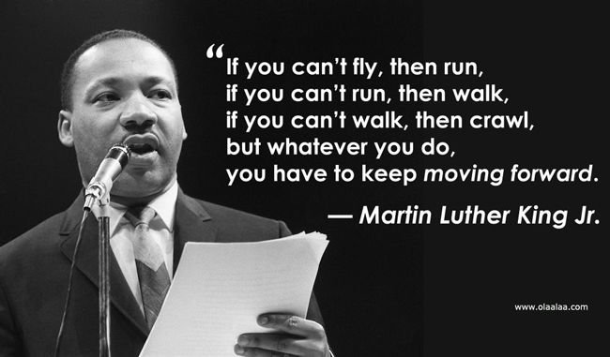
QUOTE

Slide 19
WE ARE PRINCESS MEADOW

